Slide 1
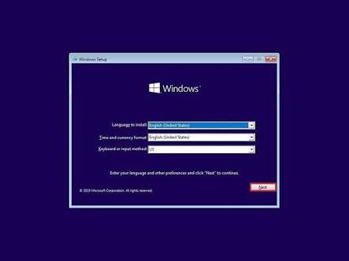
This Photo by Unknown Author is licensed under CC BY-SA-NC

Slide 2
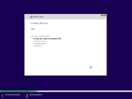
This Photo by Unknown Author is licensed under CC BY-SA

Slide 3

Windows is updating redgistry settings

Slide 4
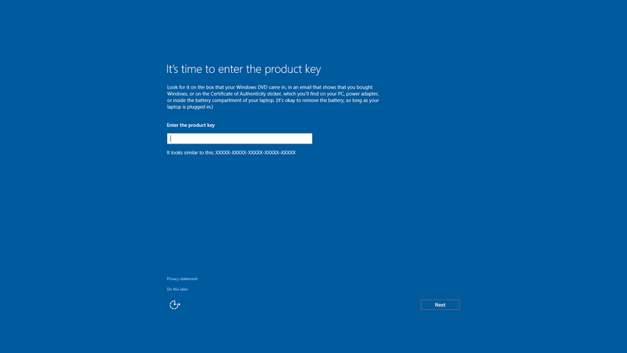
This Photo by Unknown Author is licensed under CC BY-SA

Slide 5

This Photo by Unknown Author is licensed under CC BY-SA

Slide 6
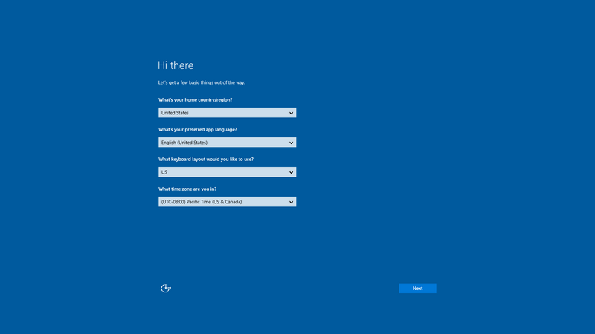
This Photo by Unknown Author is licensed under CC BY-SA

Slide 7
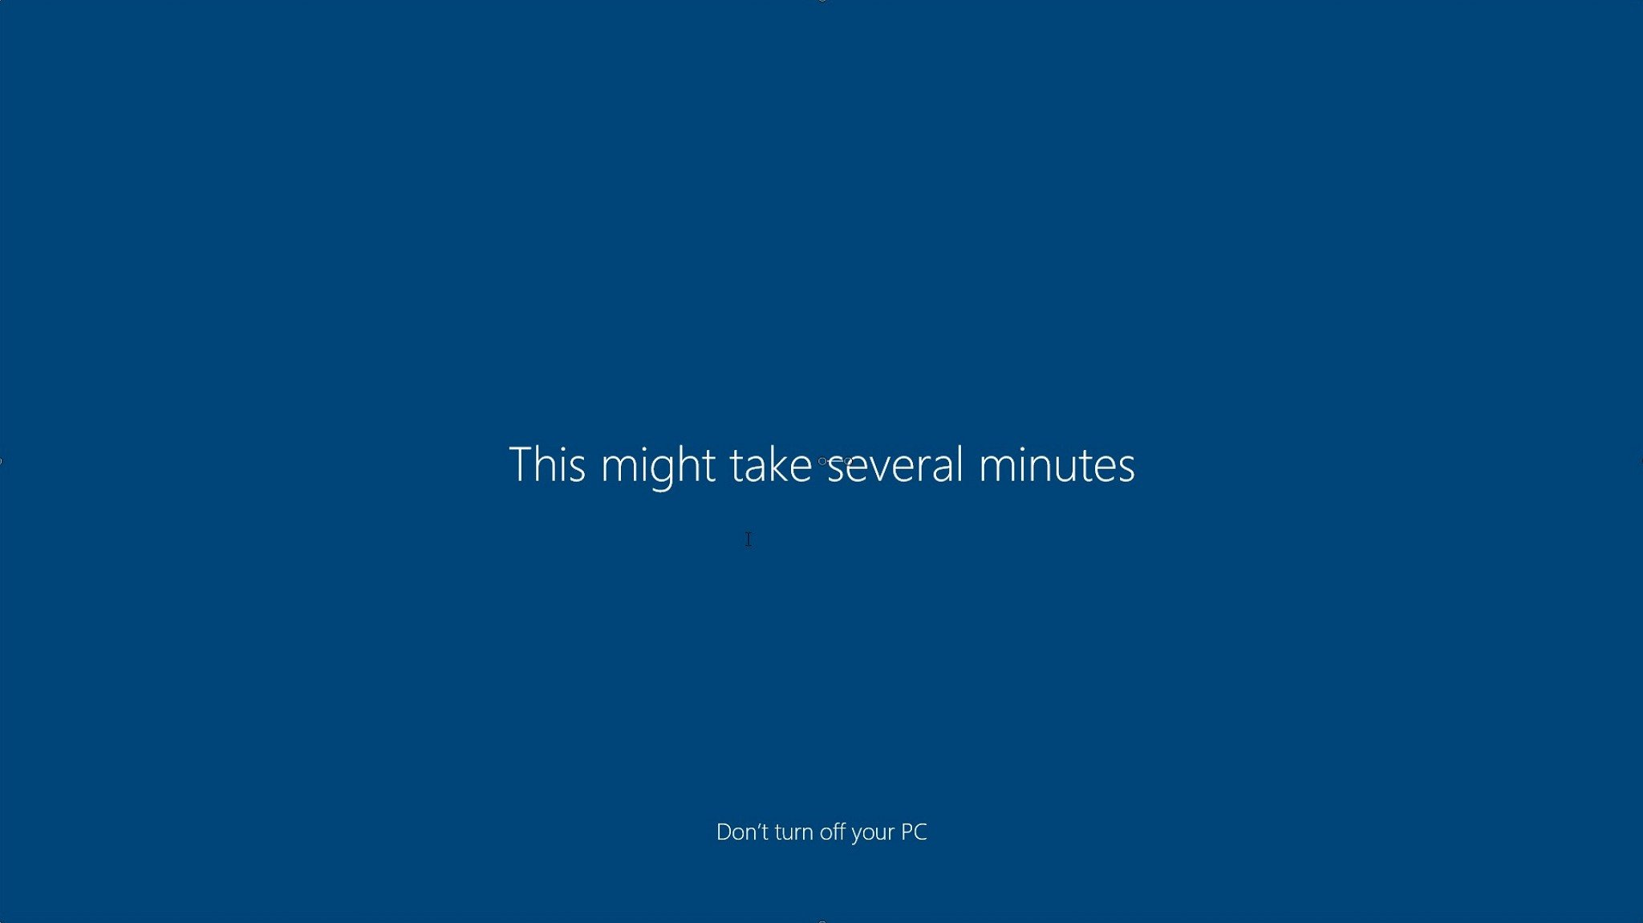

Slide 8
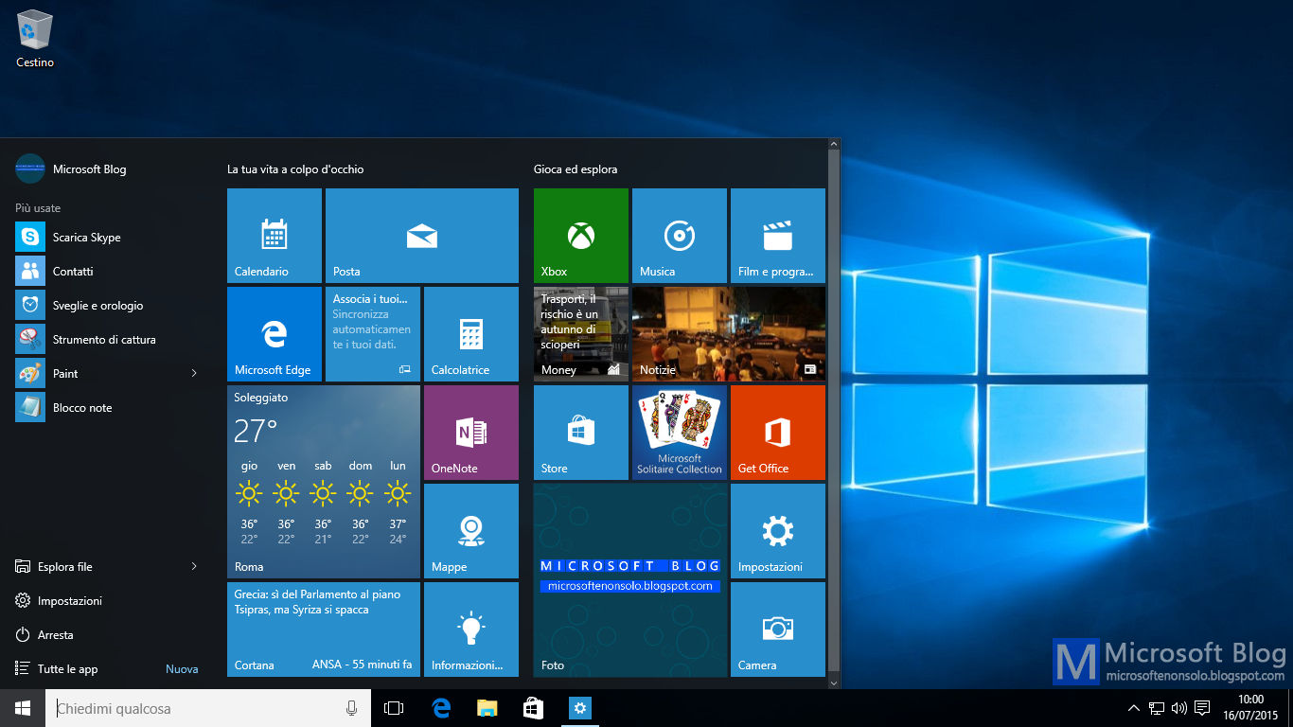
This Photo by Unknown Author is licensed under CC BY-NC

Slide 9
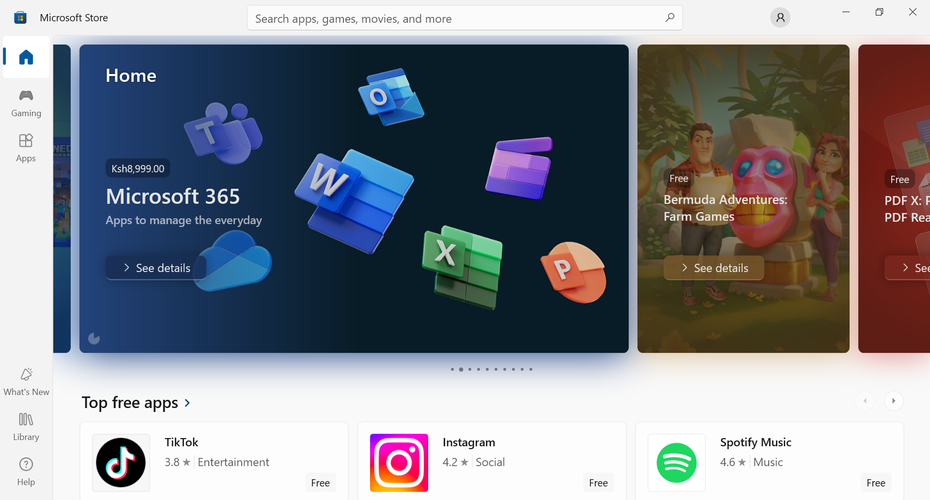


Slide 10
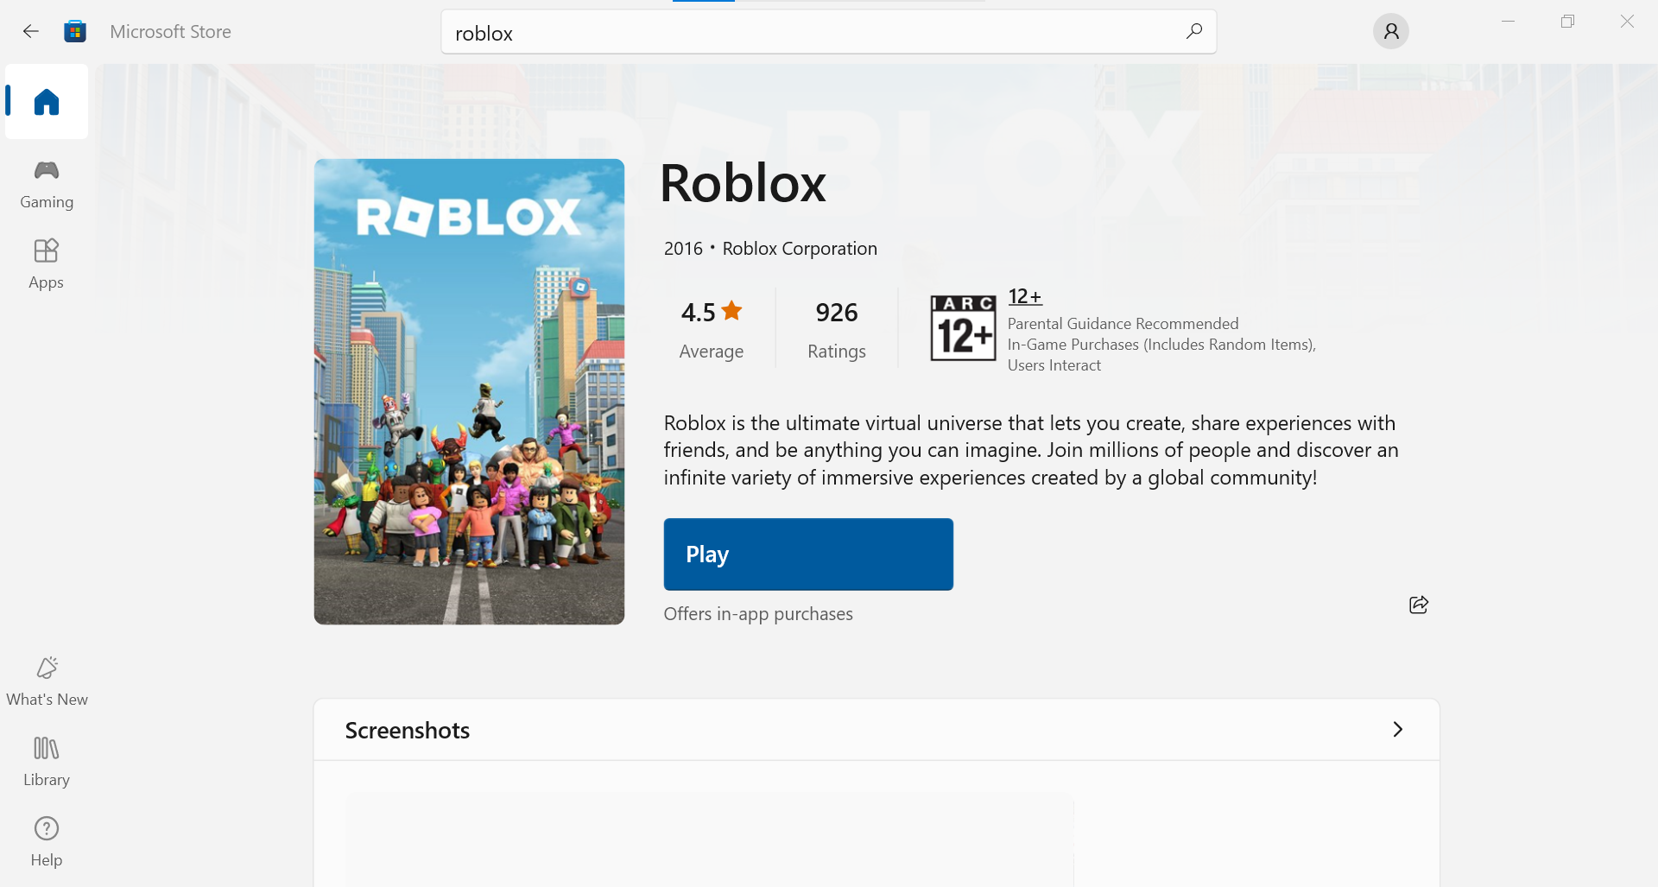

Slide 11
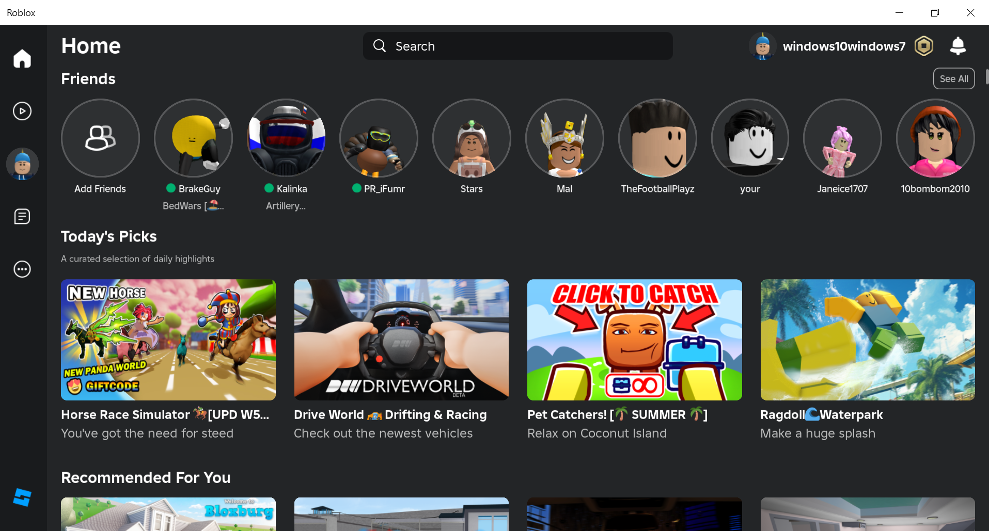

Slide 12
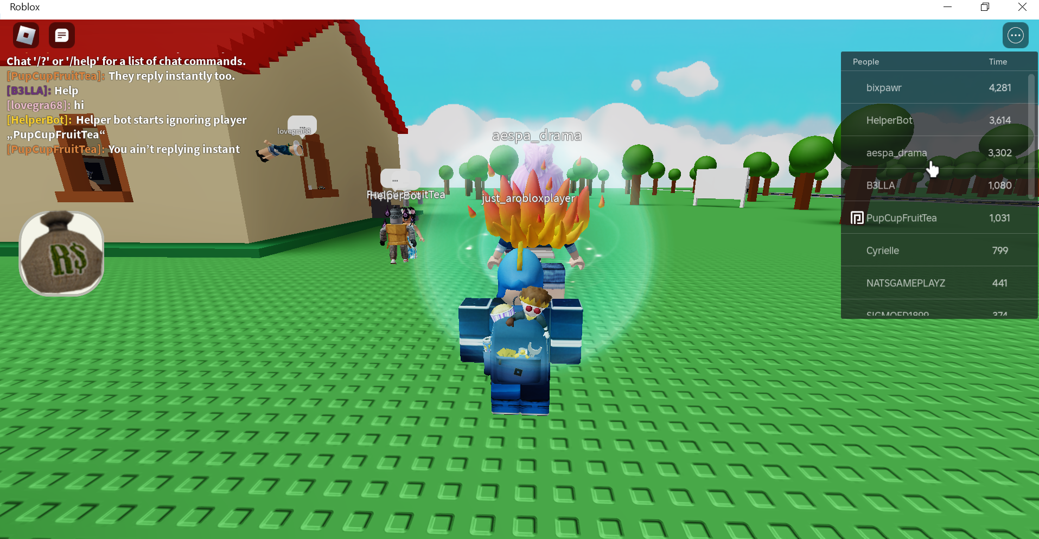

Slide 13
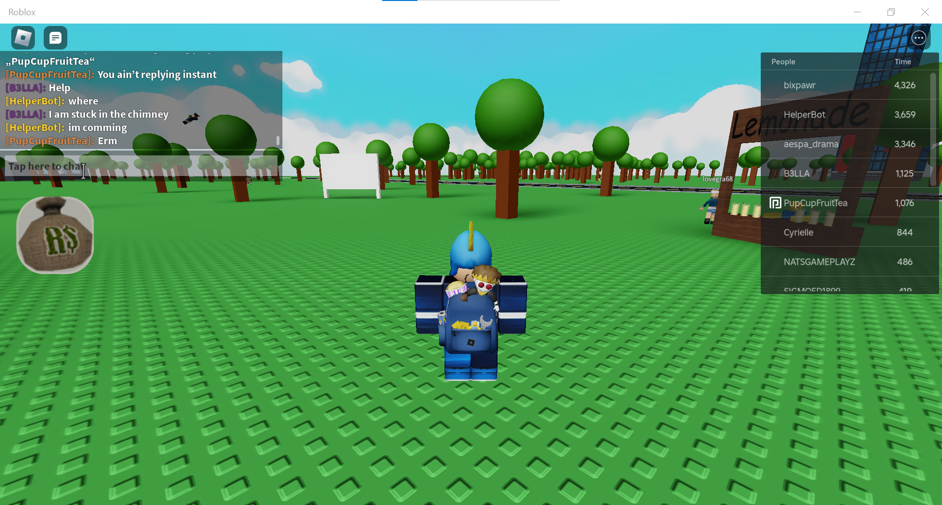

Slide 14


